Slide 1


BigData - KHMT01
CASSANDRA
Preresented by Group 03

Slide 2


Members in group 03

Slide 3

Phan Phước Hải Nam
21127365
Ngô Thị Thanh Thảo
21127433
Lê Phước Thịnh Tiến
21127700
Phạm Khánh Toàn
21127704

Slide 4


Introduction

Slide 5
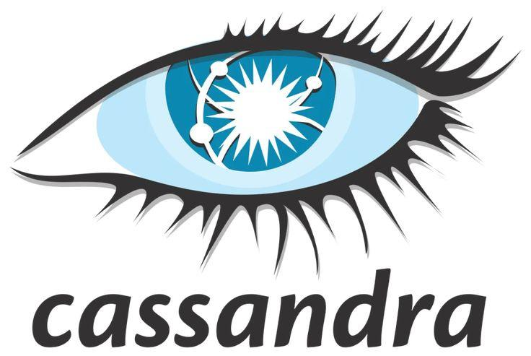
Introduction
Cassandra is an open-source, distributed NoSQL database known for scalability, high availability, and fault tolerance.
Trusted by numerous companies, it efficiently handles massive datasets across distributed environments.
Its flexible schema design and seamless horizontal scaling make it a preferred choice for managing modern data challenges.

Slide 6
History

Slide 7

Facebook's Inbox Search Problem
Cassandra originated at Facebook in 2007 to address their inbox search problem.
Faced with large volumes of data, traditional methods for scalability were insufficient.
Motivations for Development
Handling Large Volumes of Data
Facebook needed a solution capable of handling massive amounts of data efficiently.
Requirements included managing message copies,…

Slide 8
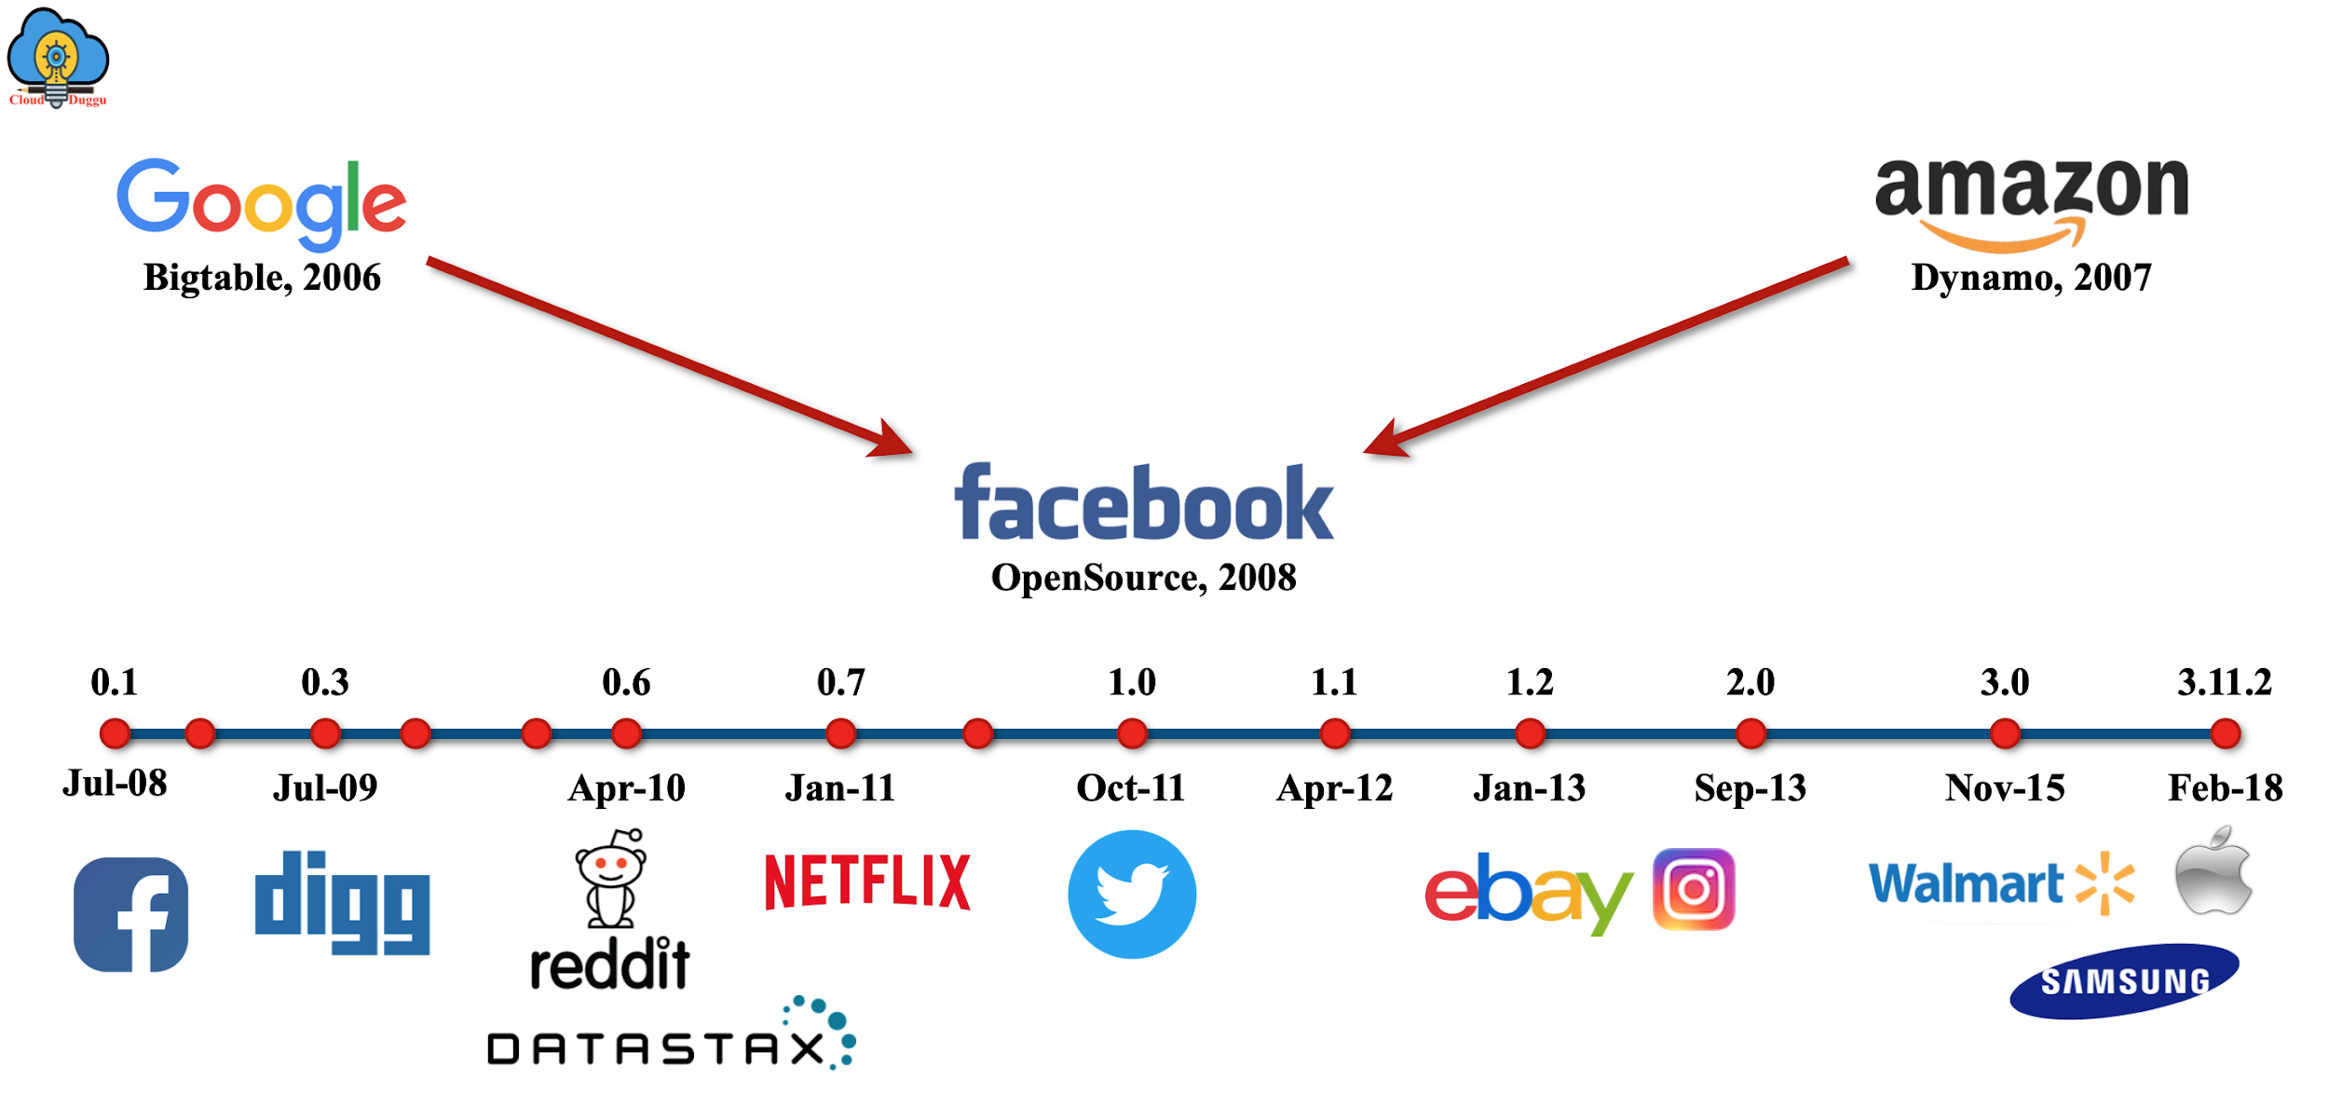
Evolution through the Years

Slide 9

Origins at Facebook
Release as an Open Source Project (2008)
Evolution through the Years
Transition to Apache Incubator (2009)
Elevation to Top-Level Project (2010)
Continued Development and Adoption

Slide 10
Popularity

Slide 11





Applications in Industry Activities
Social Media
E-commerce
Cassandra is extensively used by social media giants like Facebook and Twitter.
Adopted by major e-commerce platforms such as Amazon and eBay.
Gaming
IoT
Many gaming companies rely on Cassandra for managing player data, game state data,...
Widely used in IoT applications for storing and analyzing sensor data, device telemetry, and event streams.

Slide 12
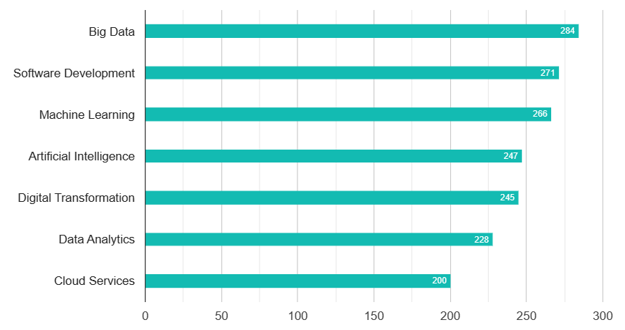
•Apache Cassandra Customers by Products and Services

Slide 13
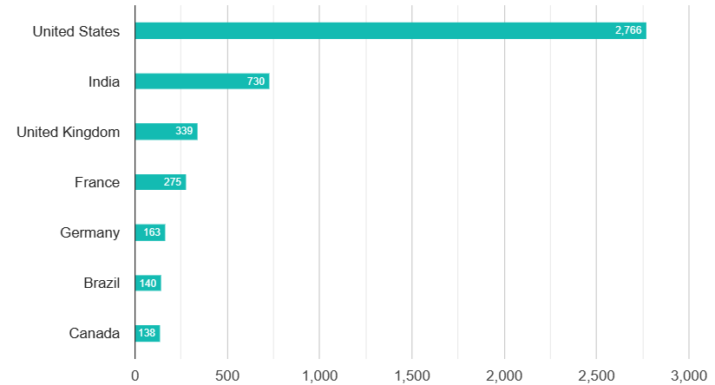
•Apache Cassandra Customers by Geography

Slide 14
KEY FEATURE

Slide 15

1. Distribution
2. Scalability
3. Replication Ensures Reliability and Fault Tolerance
4. Cassandra Column Families

Slide 16
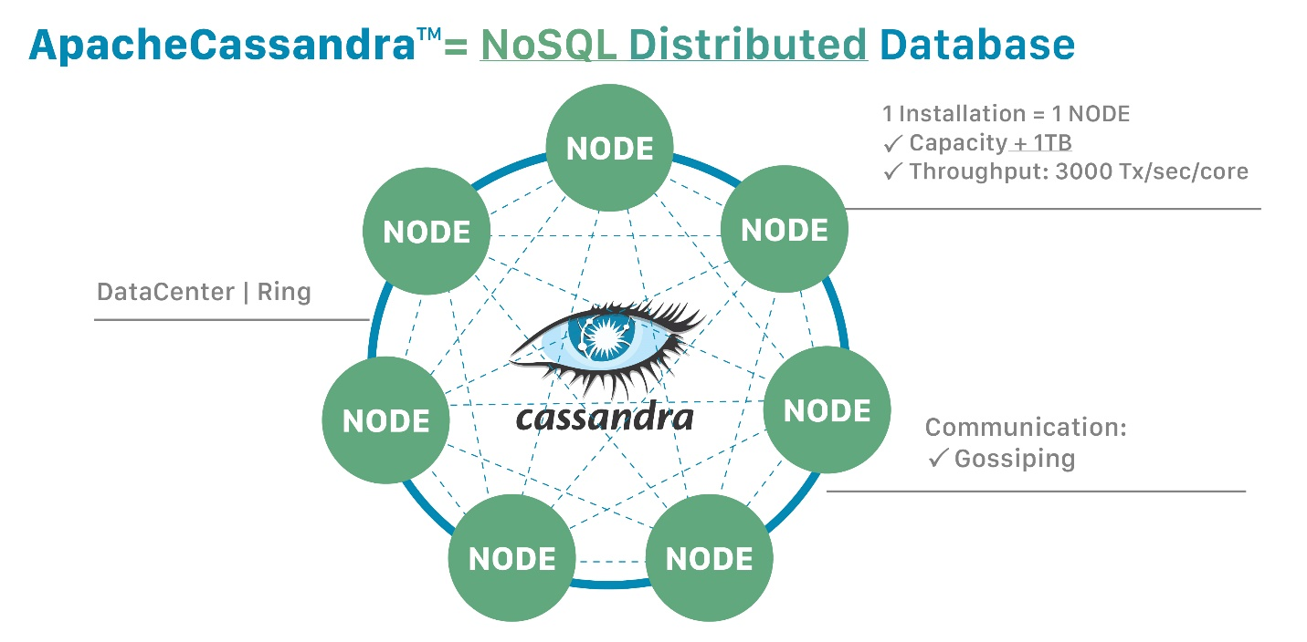

Distribution Provides Power and Resilience

Slide 17
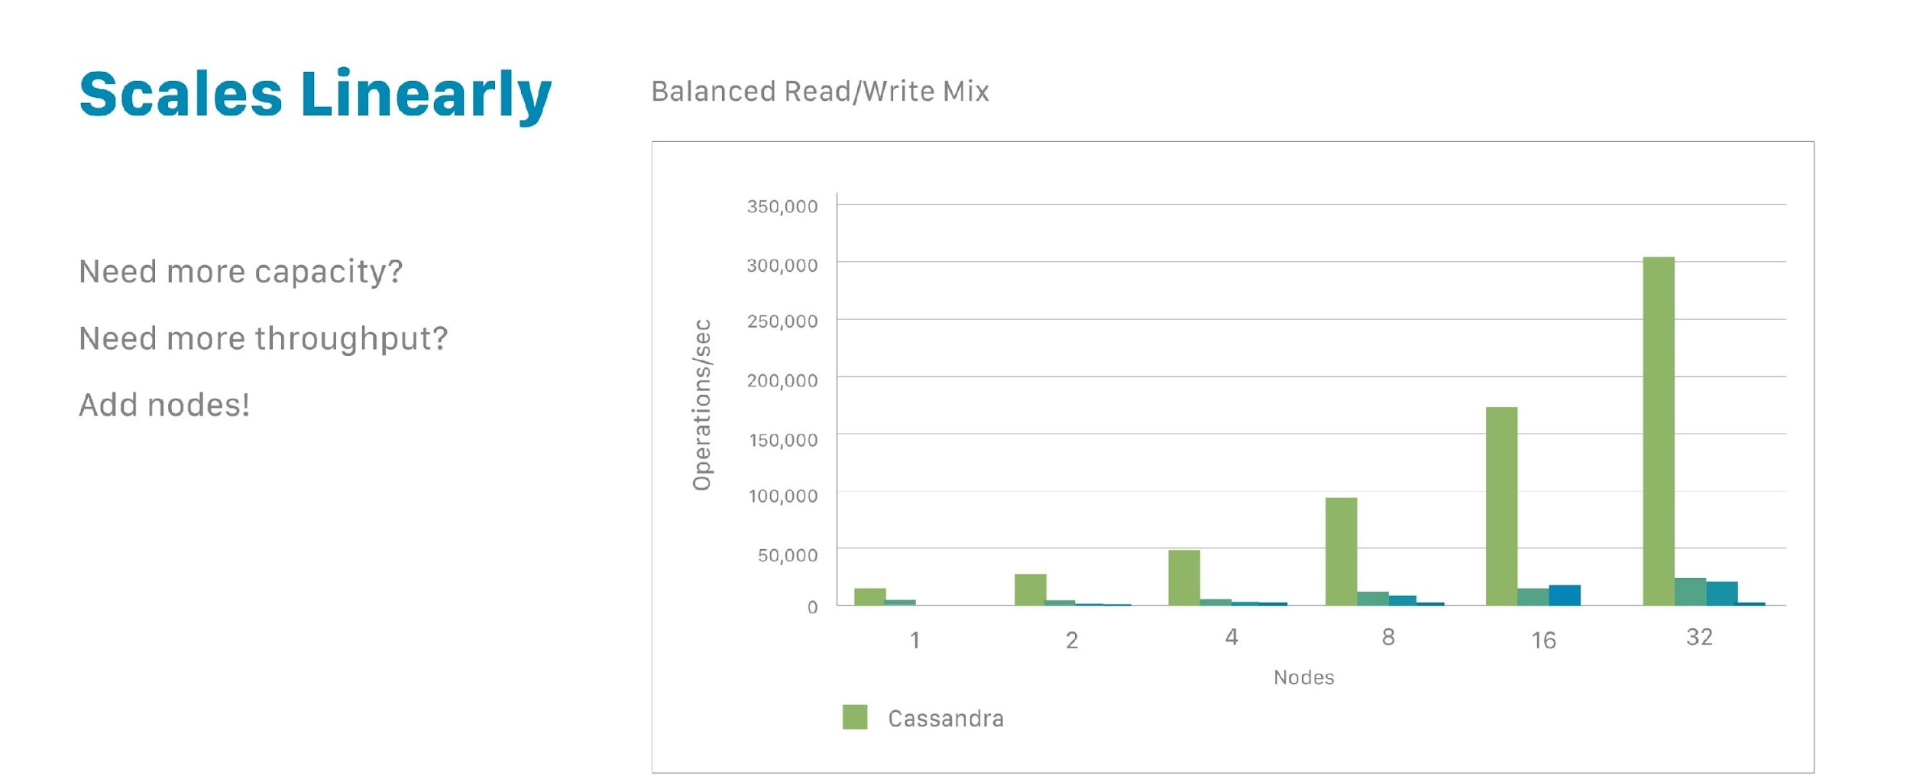
Scalability
One reason for Cassandra’s popularity is that it enables to scale databases dynamically, using off-the-shelf hardware, with no downtime.
Cassandra scales horizontally, allowing for increased data management by simply adding more nodes. Doubling capacity or throughput is as easy as doubling the number of nodes.

Slide 18
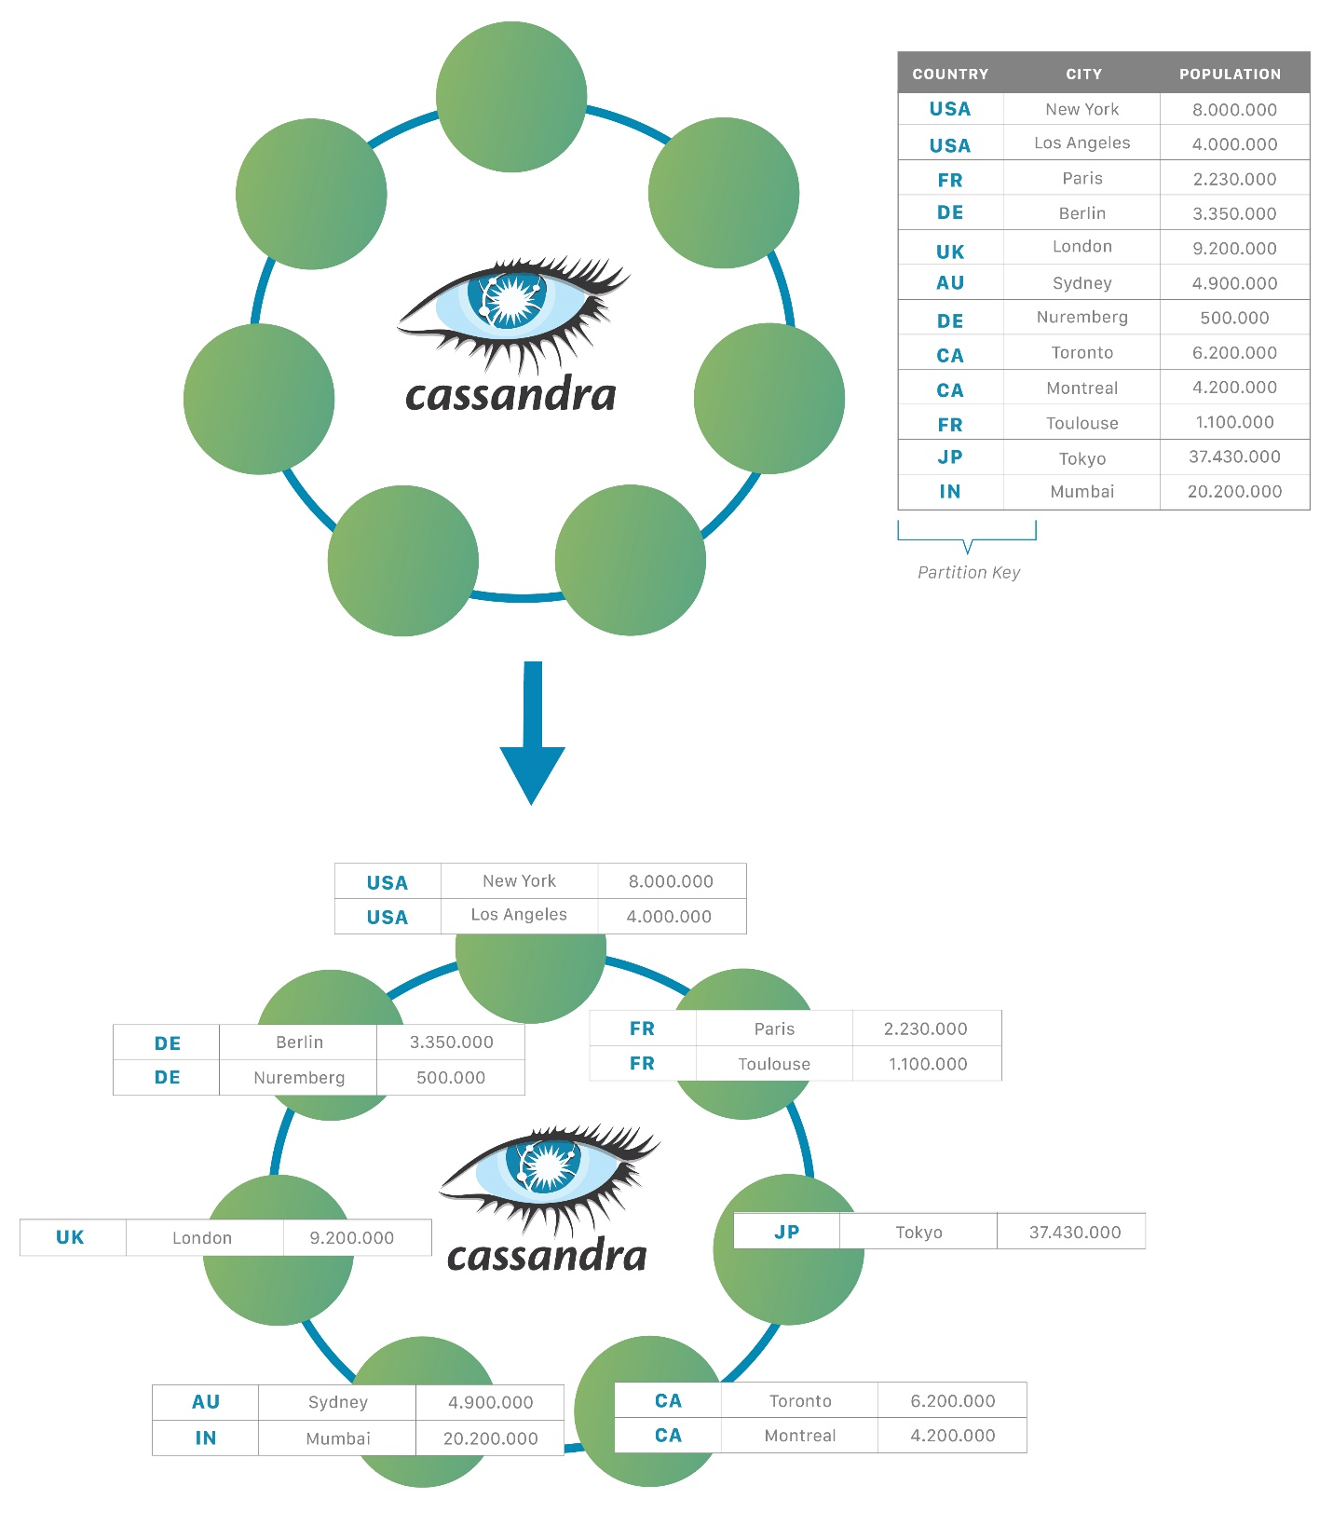
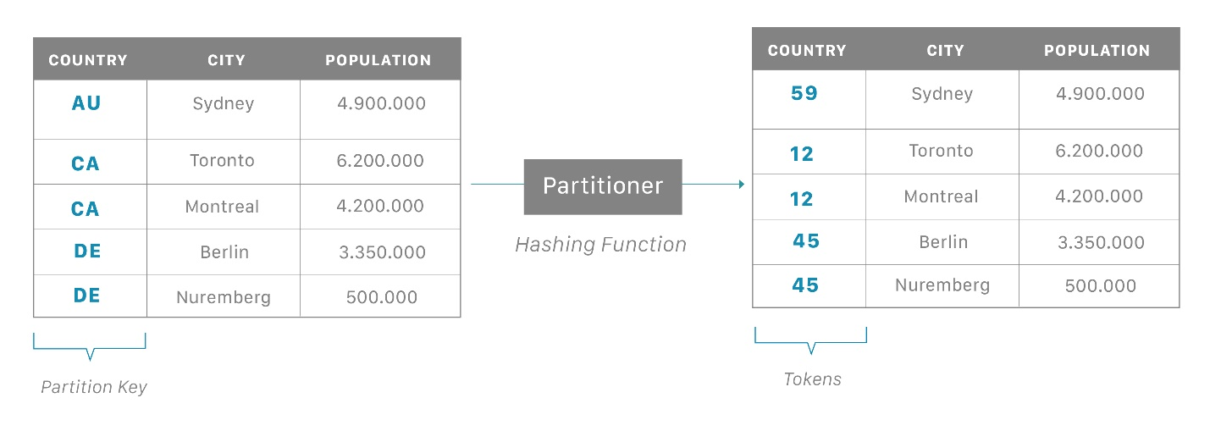
Data Distribution in Cassandra
Automatically distributed
Each node owns specific tokens
Partition key

Slide 19
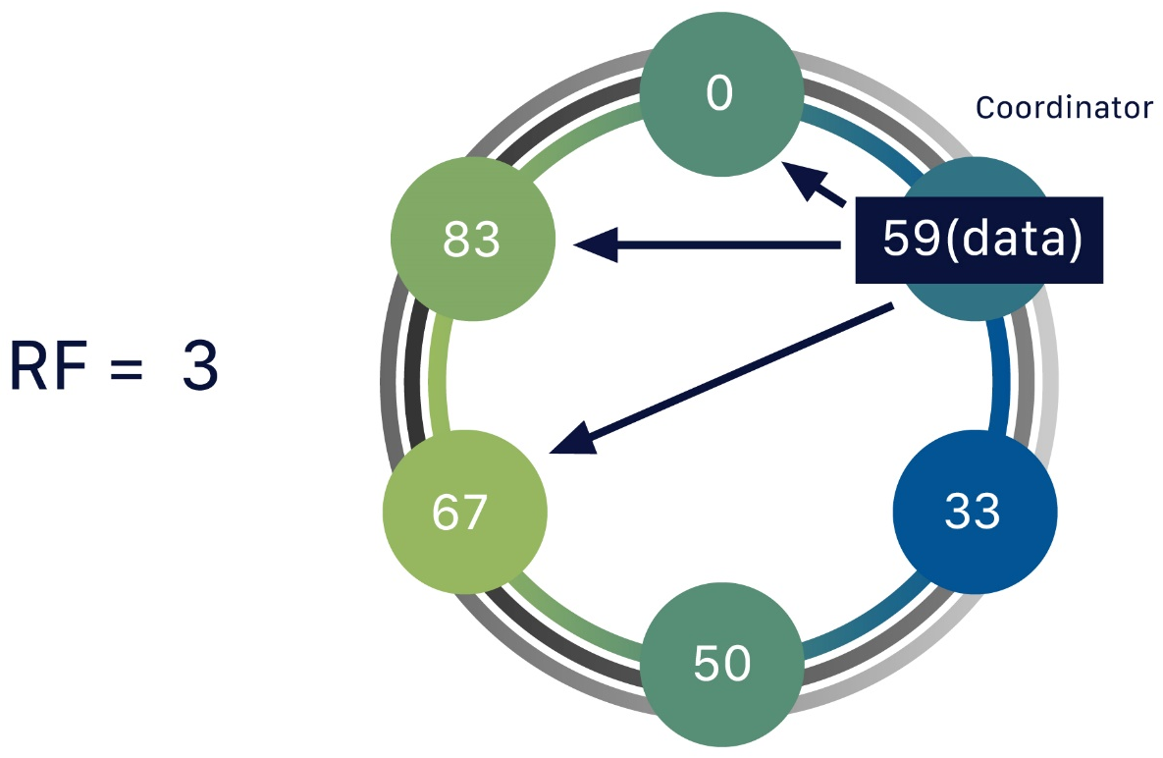
Replication Ensures Reliability and Fault Tolerance

Slide 20
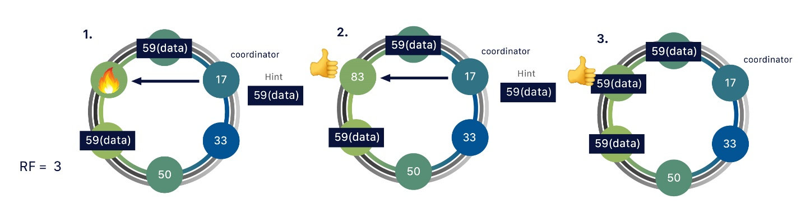
Replication Factor
Definition: The number of copies of data maintained on different nodes.
Example: A replication factor of 3 means three copies of data are stored on three different nodes.
Purpose: Ensures data redundancy and availability even if one or more nodes fail
Fault Tolerance: With a replication factor of 3, the system can withstand the failure of up to two nodes without data loss.

Slide 21
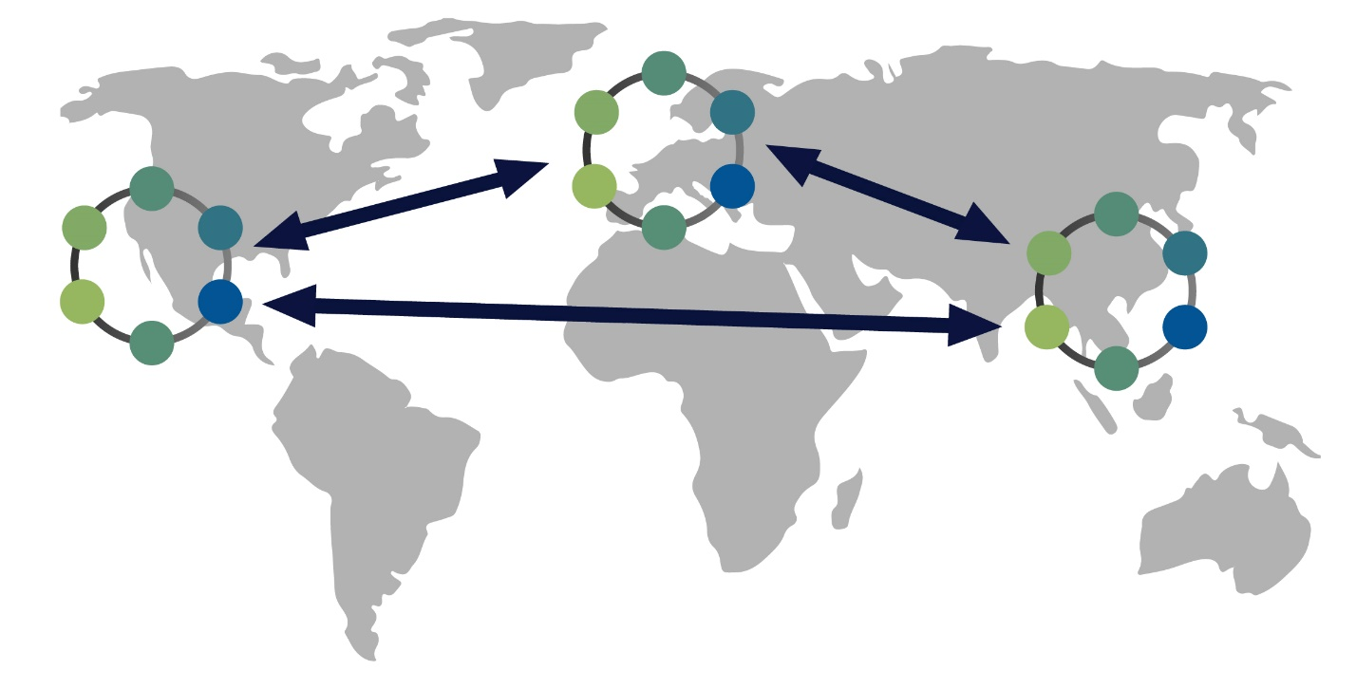
Replication Strategy

Slide 22
Simple Strategy
Network Topology Strategy
Usage: Suitable for single data center deployments.
Replication Process: Data is copied in a clockwise manner on all nodes.
Advantage: Simple to implement and manage for basic deployment scenarios.
Usage: Recommended for multi-data center deployments and future scalability.
Replication Process: Data is replicated based on network topology and data center configurations.
Advantage: Offers flexibility to adapt to changes in network architecture and data center expansions.

Slide 23
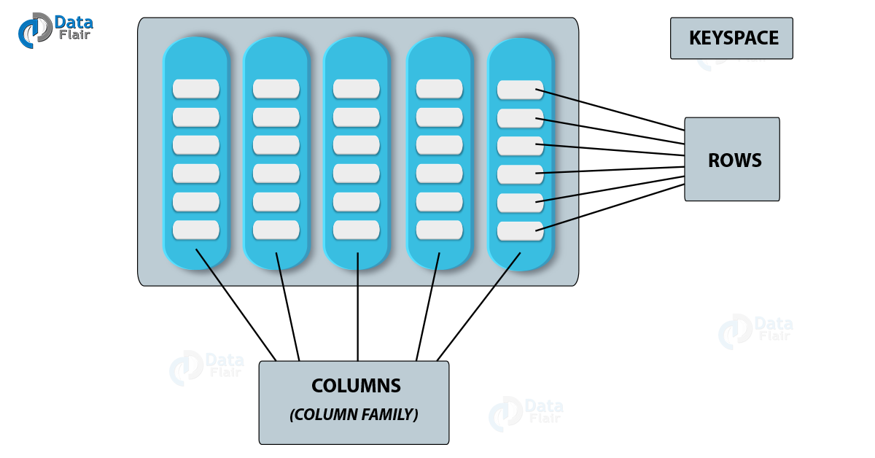
Cassandra Column Families
Column Family: organizes data into rows containing ordered columns.
Each Column Family resides within a Keyspace, representing a logical container for data.
Keyspaces contain at least one Column Family, defining the data organization.

Slide 24
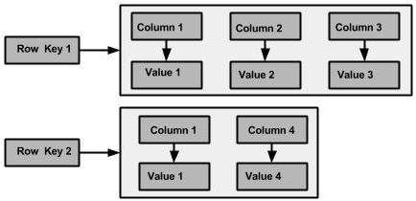
Cassandra Column Families
Rows hold multiple columns, comprising key and value attributes.
Columns can be dynamically added or removed, adapting to changing data needs

Slide 25
Major Components

Slide 26
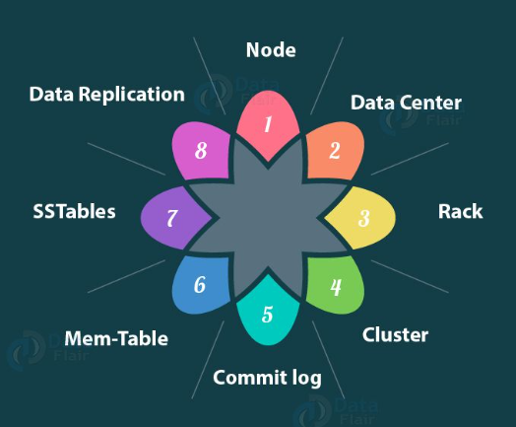
Major Components

Slide 27
Node
Location where data is stored.
A single server in a rack
There is no single point of failure

Slide 28
Rack
A rack represents a logical grouping of nodes within the ring
can send operations not only to just one node
used to provide fault tolerance

Slide 29
Data Center
A logical set of racks
Helps to reduce latency
Data can be written to different data centers

Slide 30
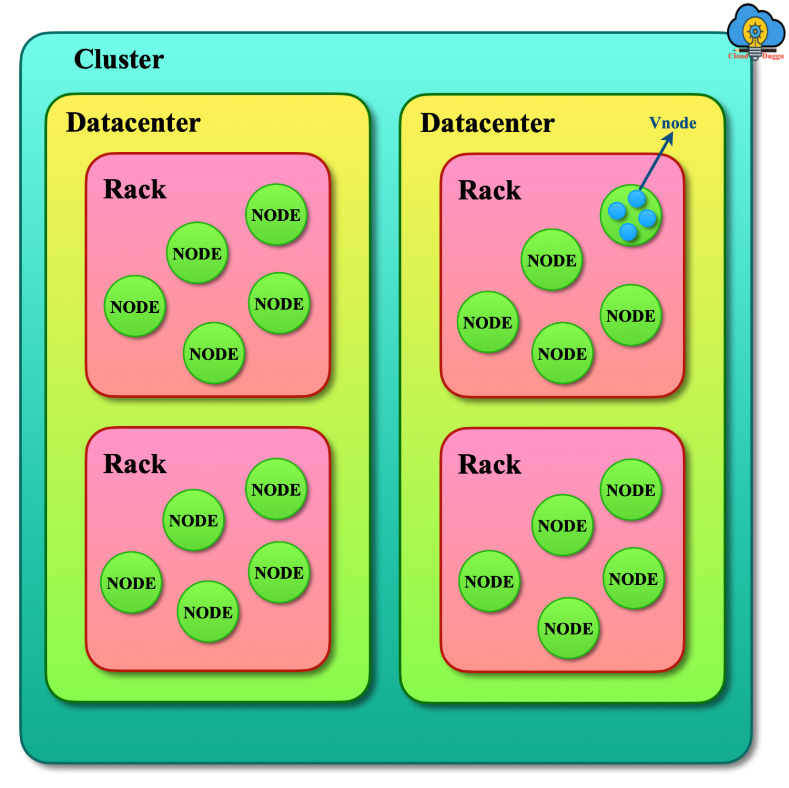
Cluster
Component containing one or more data centers.
Most outer storage container
One database contains one or more clusters

Slide 31
Commit Log
Every write operation is written to Commit Log
Commit log is used for crash recovery
The commit log can be archived, deleted or recycled

Slide 32
SSTable
Ordered immutable key-value map
Data is stored after being flushed from the mem-table
optimize disk space and improve read performance.

Slide 33
Mem-Table
Data from the commit log is written to the mem-table.
Data is written in Mem-table temporarily
very fast write operations

Slide 34
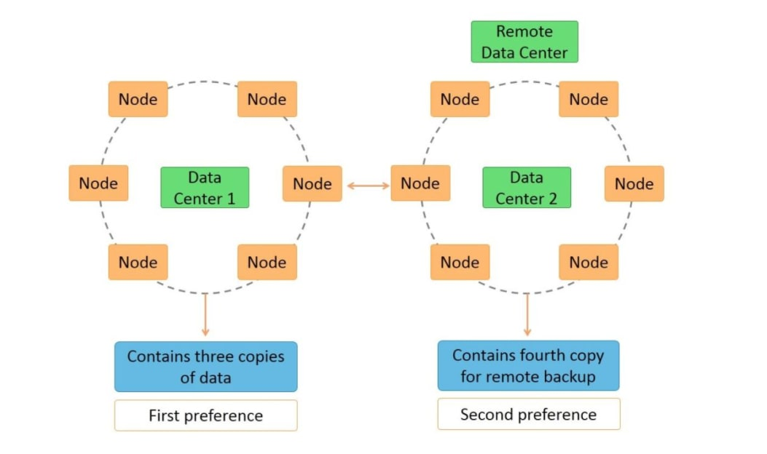
Replication Factor

Slide 35
Other Components

Slide 36
Gossip
discover node state for all nodes in a cluster
allow the nodes to communicate with each other
detect any faulty nodes in the cluster

Slide 37
Partitioner
Decides which node has to receive the first replica
Taking care of the distribution of these replicas
A hash function

Slide 38
Snitch
Helps in getting the place where replicas are to be placed
Dynamic layer
Used to discover the overall network overall topology

Slide 39
Merkle Tree
A hash tree
Find differences in data blocks
Leaf nodes contain hashes. Parent nodes contain hashes of their respective children

Slide 40
Comparision

Slide 41
Comparision
Similarity: NoSQL Database, scalability, high availability, Distributed Architecture
Difference

Slide 42
Cassandra & MongoDB
Feature | Cassandra | MongoDB
Data Model | Column-family data model | Document-oriented data model based on BSON
Query Language | CQL(Cassandra Query Language) | Rich query language supporting field, range, and regular expression queries
Architecture | Decentralized, masterless | Master-slave replication
Scalability | Linear scalability with distributed architecture | Horizontal scaling with sharding
Secondary indexes | Does not fully support secondary indexes. It relies on primary keys to fetch information | Fully supports secondary indexes that can enhance query speeds
Aggregation | Does not have an aggregation framework | Has a built-in aggregation framework

Slide 43
Cassandra & Hbase
Feature | Cassandra | Hbase
Data Model | Column-family data model | Column-oriented NoSQL database
Query Language | CQL(Cassandra Query Language) | Shell command
Architecture | Decentralized, masterless | Master-Slave Architecture Model.
Scalability | Linear scalability with distributed architecture | Same as Cassandra
Secondary indexes | Does not fully support secondary indexes. It relies on primary keys to fetch information | Doesn't have indexes. It has ordered keys
Aggregation | Does not have an aggregation framework | Can support aggregation through various approaches

Slide 44
Cassandra & Bigtable
Feature | Cassandra | BigTable
Data Model | Column-family data model | Employs a sparse, distributed, persistent multidimensional sorted map data model
Query Language | CQL(Cassandra Query Language) | Does not provide a query language
Architecture | Decentralized, masterless | Centralized architecture with a master node
Scalability | Linear scalability with distributed architecture | Manual sharding and management of tablets to achieve scalability
Secondary indexes | Does not fully support secondary indexes. It relies on primary keys to fetch information | Does not natively support secondary indexes. Instead typically design schema based on access patterns
Aggregation | Provides limited support for aggregation | Lacks built-in aggregation functions

Slide 45
Conclusion

Slide 46
Advantage
It deals with a large amount of unstructed data
The partition tolerance feature is useful
Acts as a distributor among clusters, enhancing scalability

Slide 47
Disadvantage
The initial stage learning curve in is tedious
Lack of SQL query features
Limited commercial versions are available, with high licensing costs
Cassandra is incapable of joining, making it a challenge to use it for more complicated things like online transactions

Slide 48
Disadvantage
Absence of translation support
Not suitable for OLTP-type transaction-oriented and high-concurrency systems
No sufficient video presentations for trainers

